Slide 1
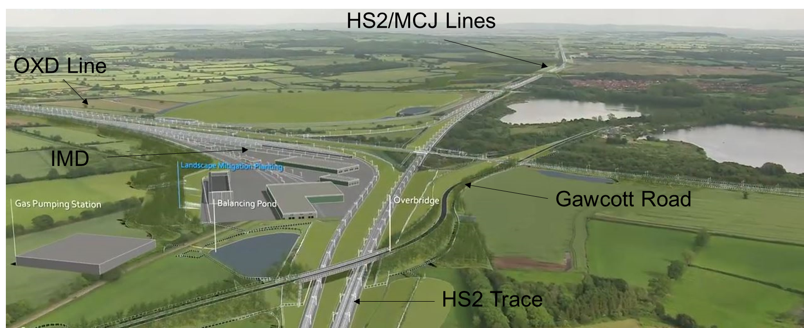
Calvert Area
Liaison Meeting
29th July 2021
Chris James
David Griffiths Allen

Slide 2
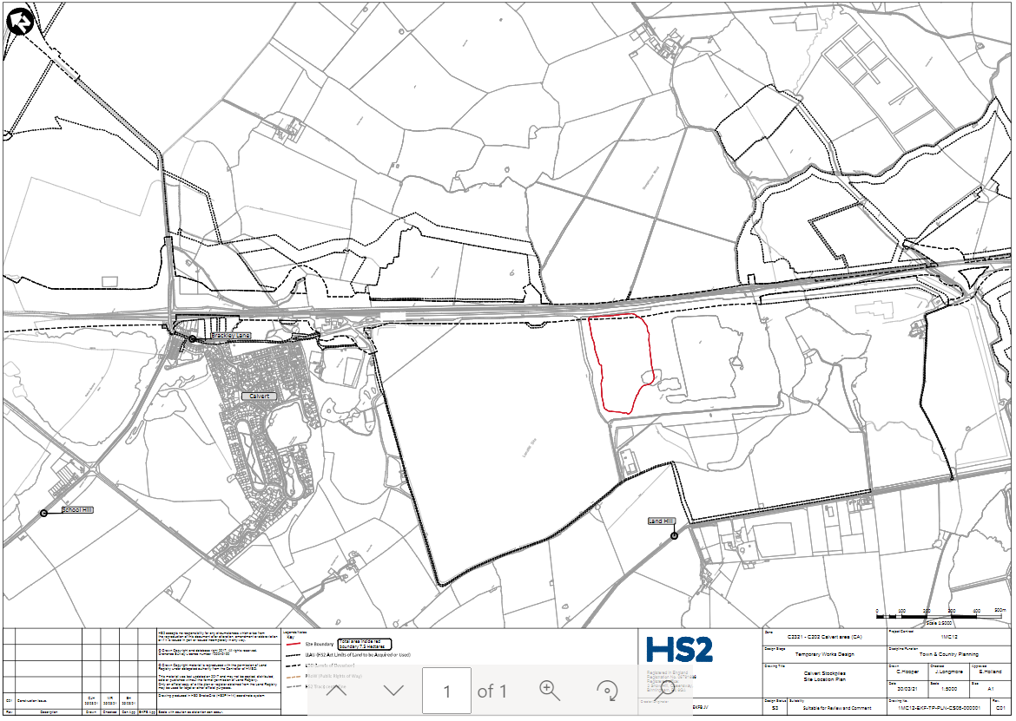
Calvert South Rail Head
Calvert South (FCC)
7 Hectares
Up to 6 metres heigh
Once spoil not required is removed.
Returned to FCC
Used to end of 2024

Slide 3
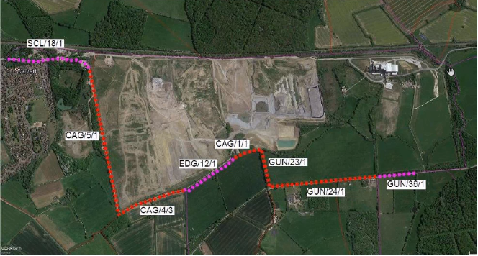
CALM meeting slide February 2021
Bridleways GUN/25
Closure during construction when not vicinity is not safe due to construction activity.
Discussions with BCC to clarify timescales.
Permanent design provides new bridleway access over the new railway.
Bridleway Improvement Works
to start in August

Slide 4
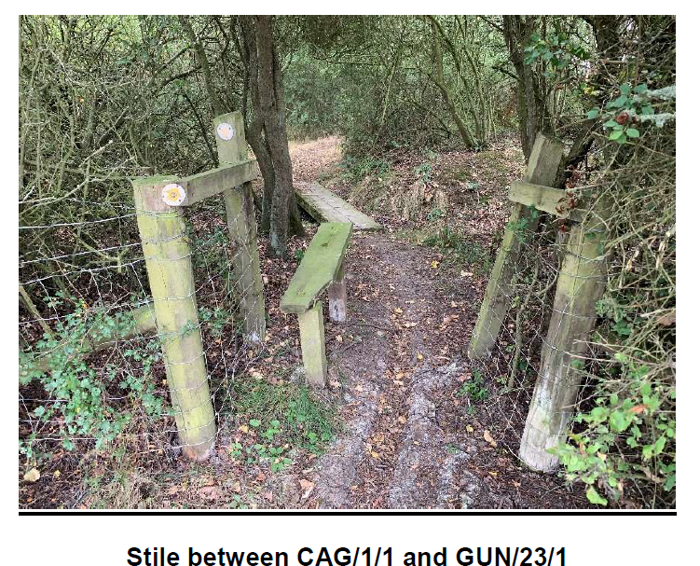
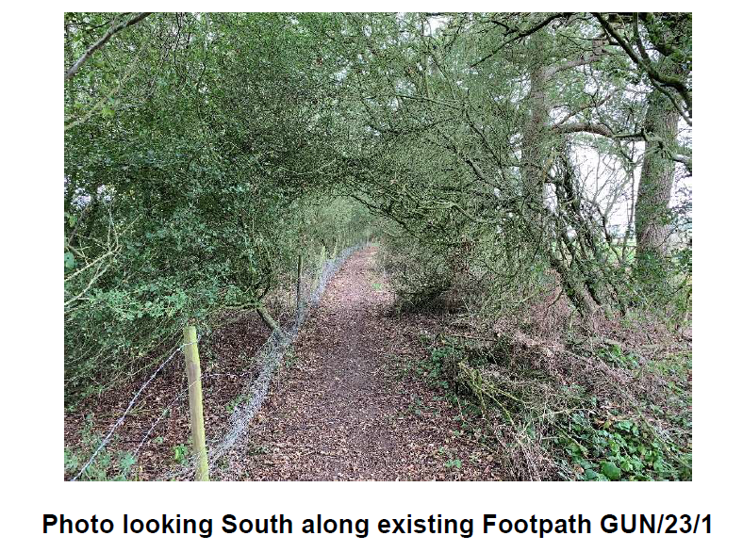
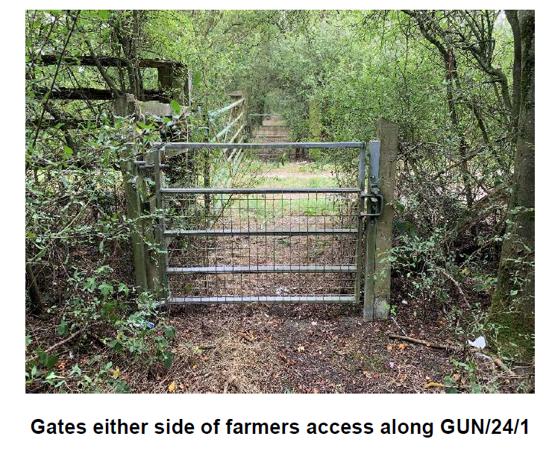
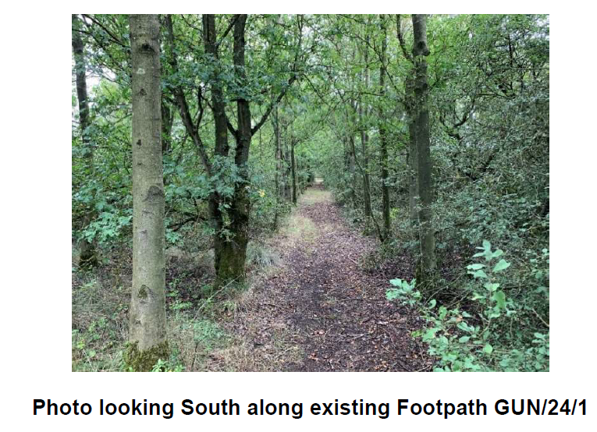
Bridleways GUN/25
Closure during construction when not vicinity is not safe due to construction activity.
Discussions with BCC to clarify timescales.
Permanent design provides new bridleway access over the new railway.

Slide 5
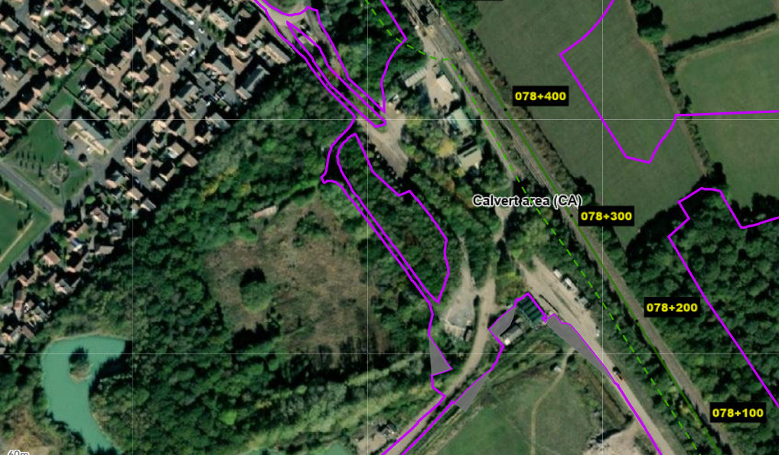

Slide 6
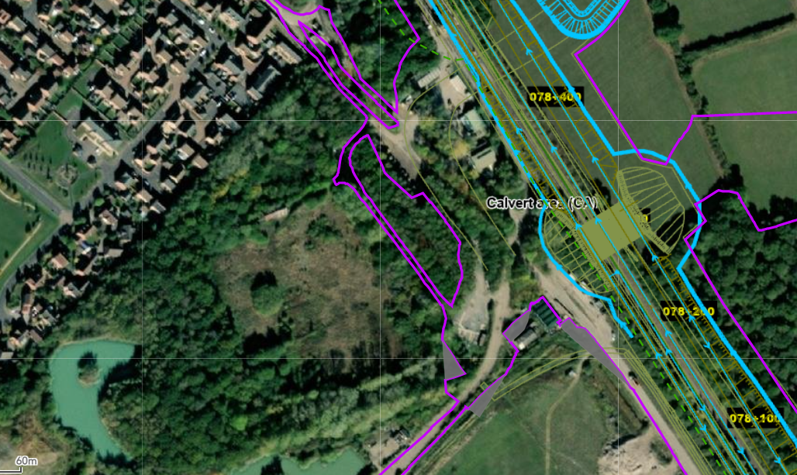

Slide 7
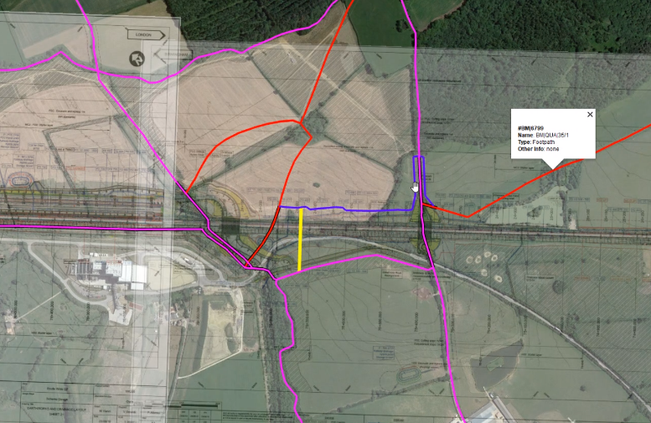

Slide 8
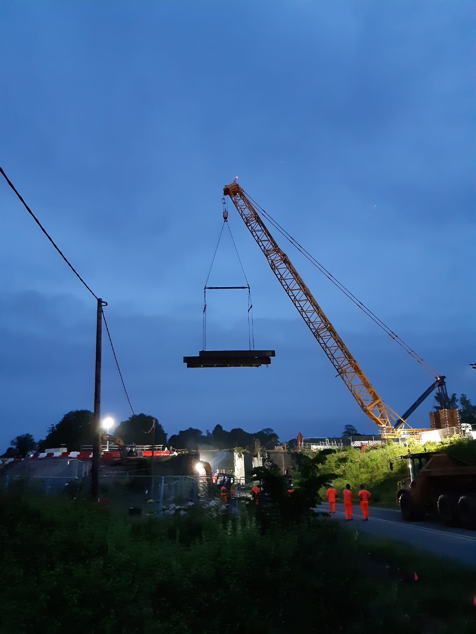

Slide 9
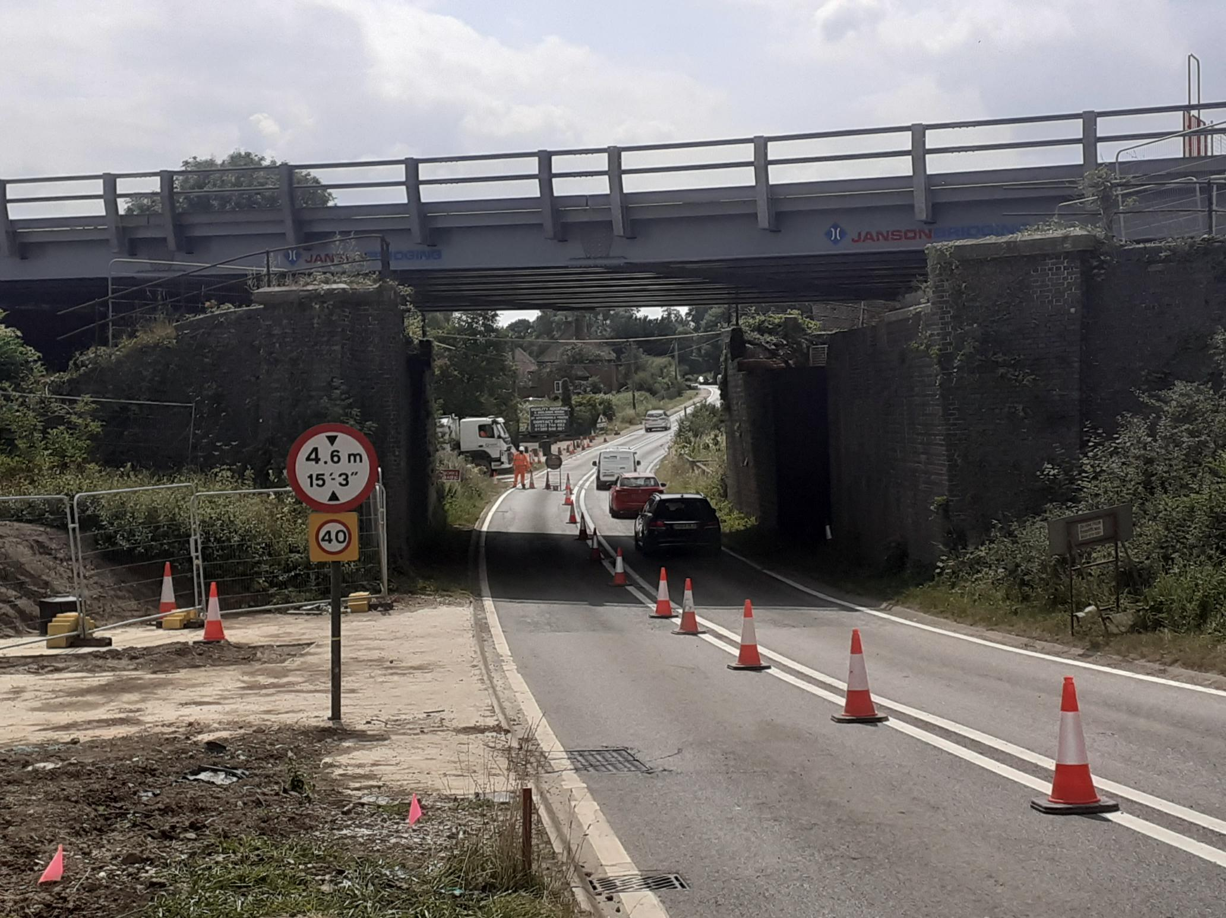

Slide 10
Calvert Area
Liaison Meeting
29th July 2021
Chris James
David Griffiths Allen

